Slide 1

Transparency: the future of food
Presented by:
Jonathan Hawes
Director, Business Development
jhawes@yottamark.com
August 2010
CSSI: Environmental Science & Resource Management
Notes:
Hello, thanks for having me here…..I’m excited by what you are planning to do…..

Slide 2
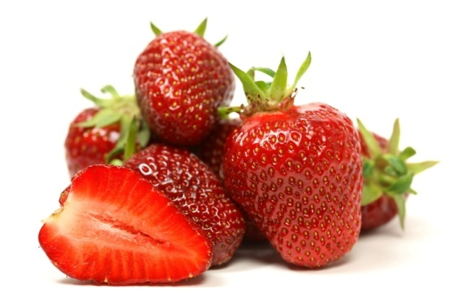
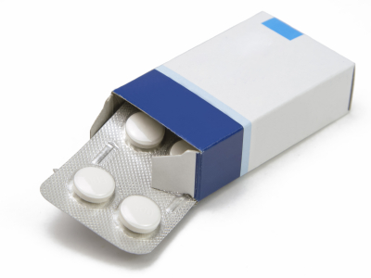
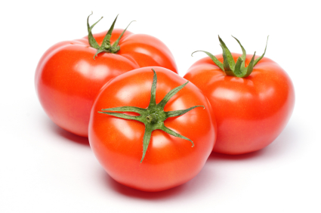
What is Traceability?
A whole new way of thinking about the information associated with products
Where was I grown?
Am I safe?
Am I authentic or recalled?
Notes:
When we use the word “traceability” we mean a whole new way of thinking about the information associated with products. For example…..Where was I grown? How was I grown? Am I safe? Am I subject to a current recall? Am I authentic?

Slide 3








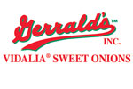







A bit of experience
Trusted leader in food traceability – founded 2004
Over 1.4 billion items traced, 150+ grower/shippers currently using HarvestMark
Infrastructure in place
Customer awareness and preference strong and growing
Notes:
And we’ve been doing this for a while. Lots of experience. Lots of skinned knees. Learned that whatever you do in the world of traceability, you have to absolutely *minimize* the impact on the producers. Food producers (of any kind) do not have the margins of Apple Computer or Google.

Slide 4
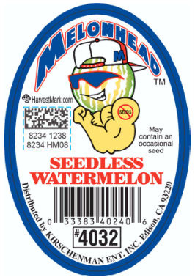
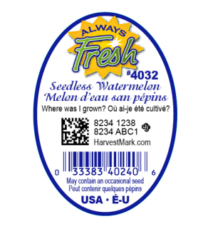
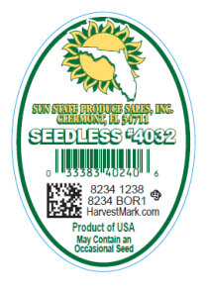
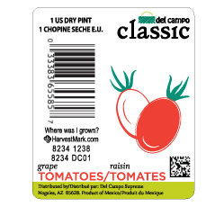
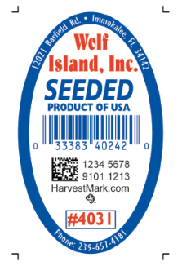
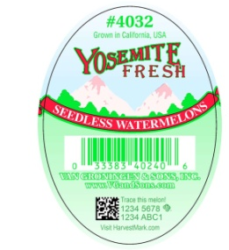
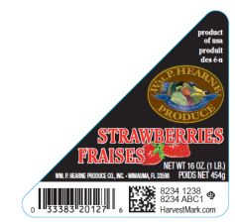
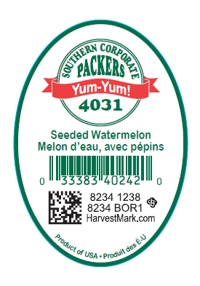
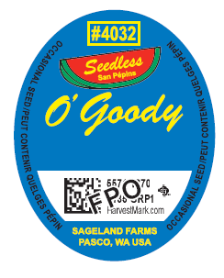
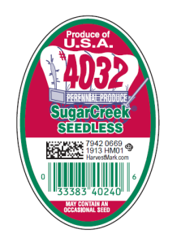
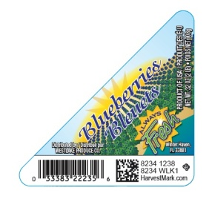
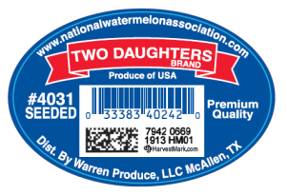
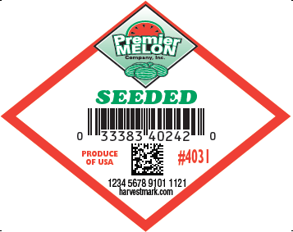
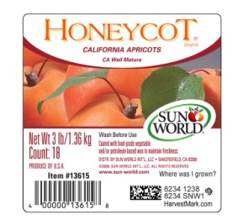
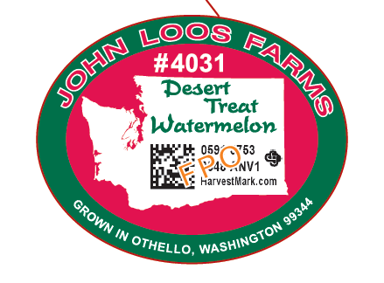
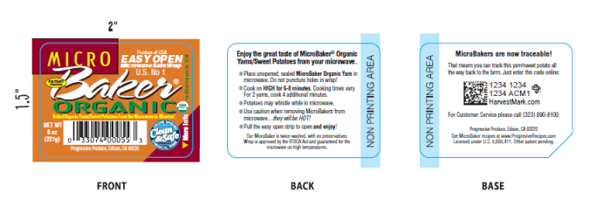
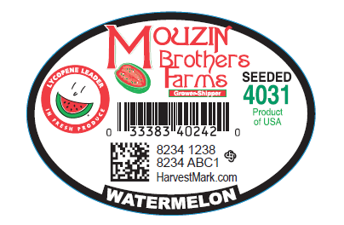
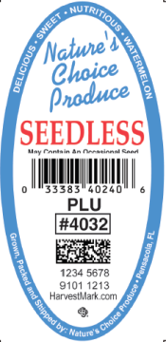
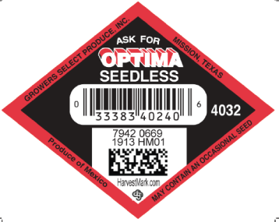
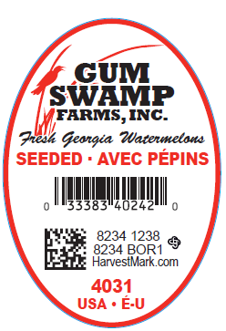
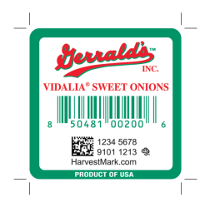
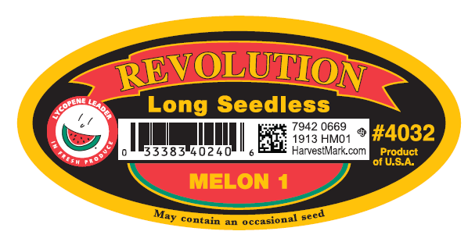
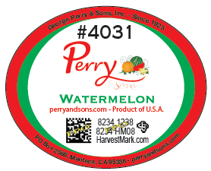
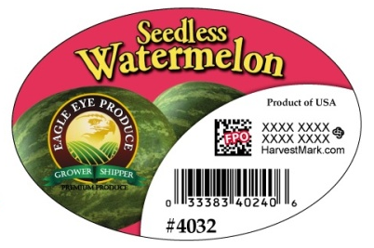
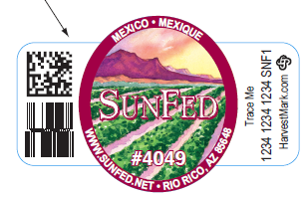
Traceability is happening now….

Slide 5
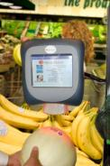
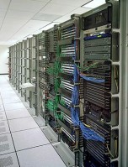
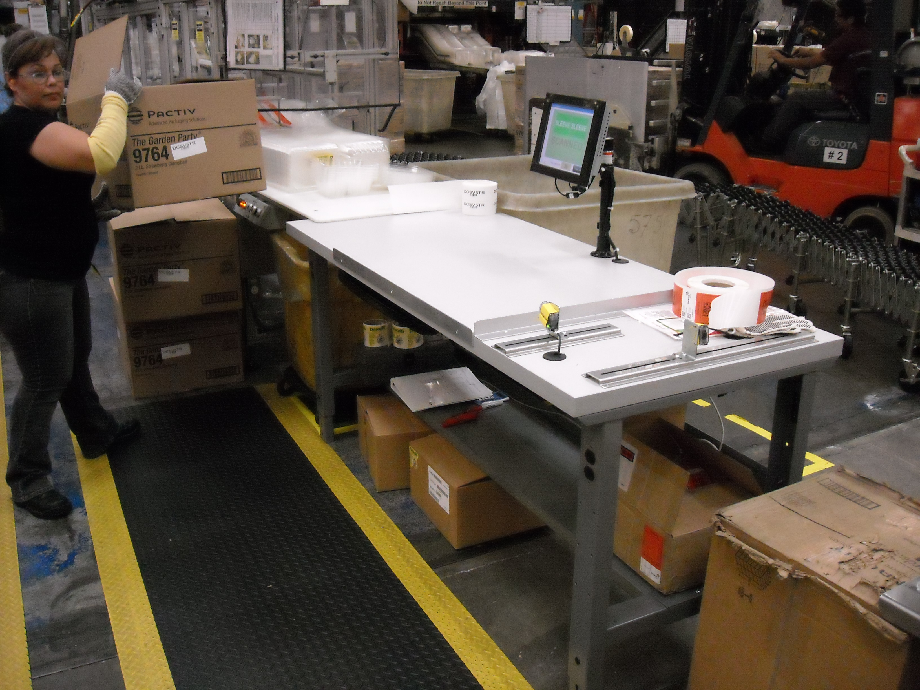

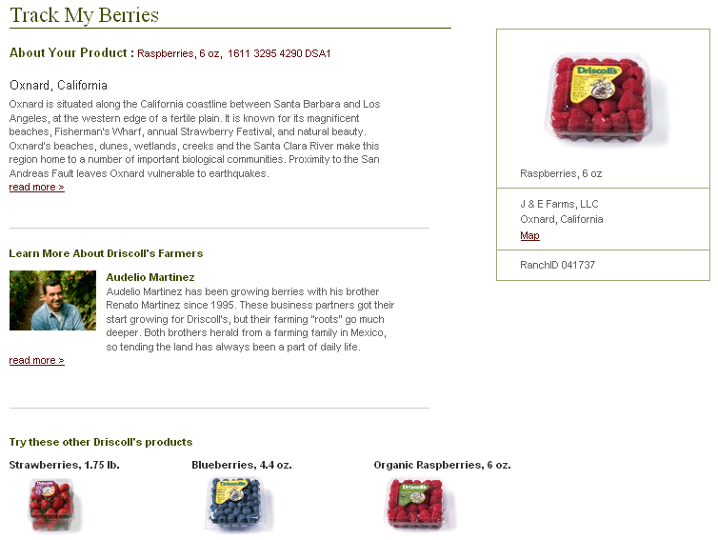


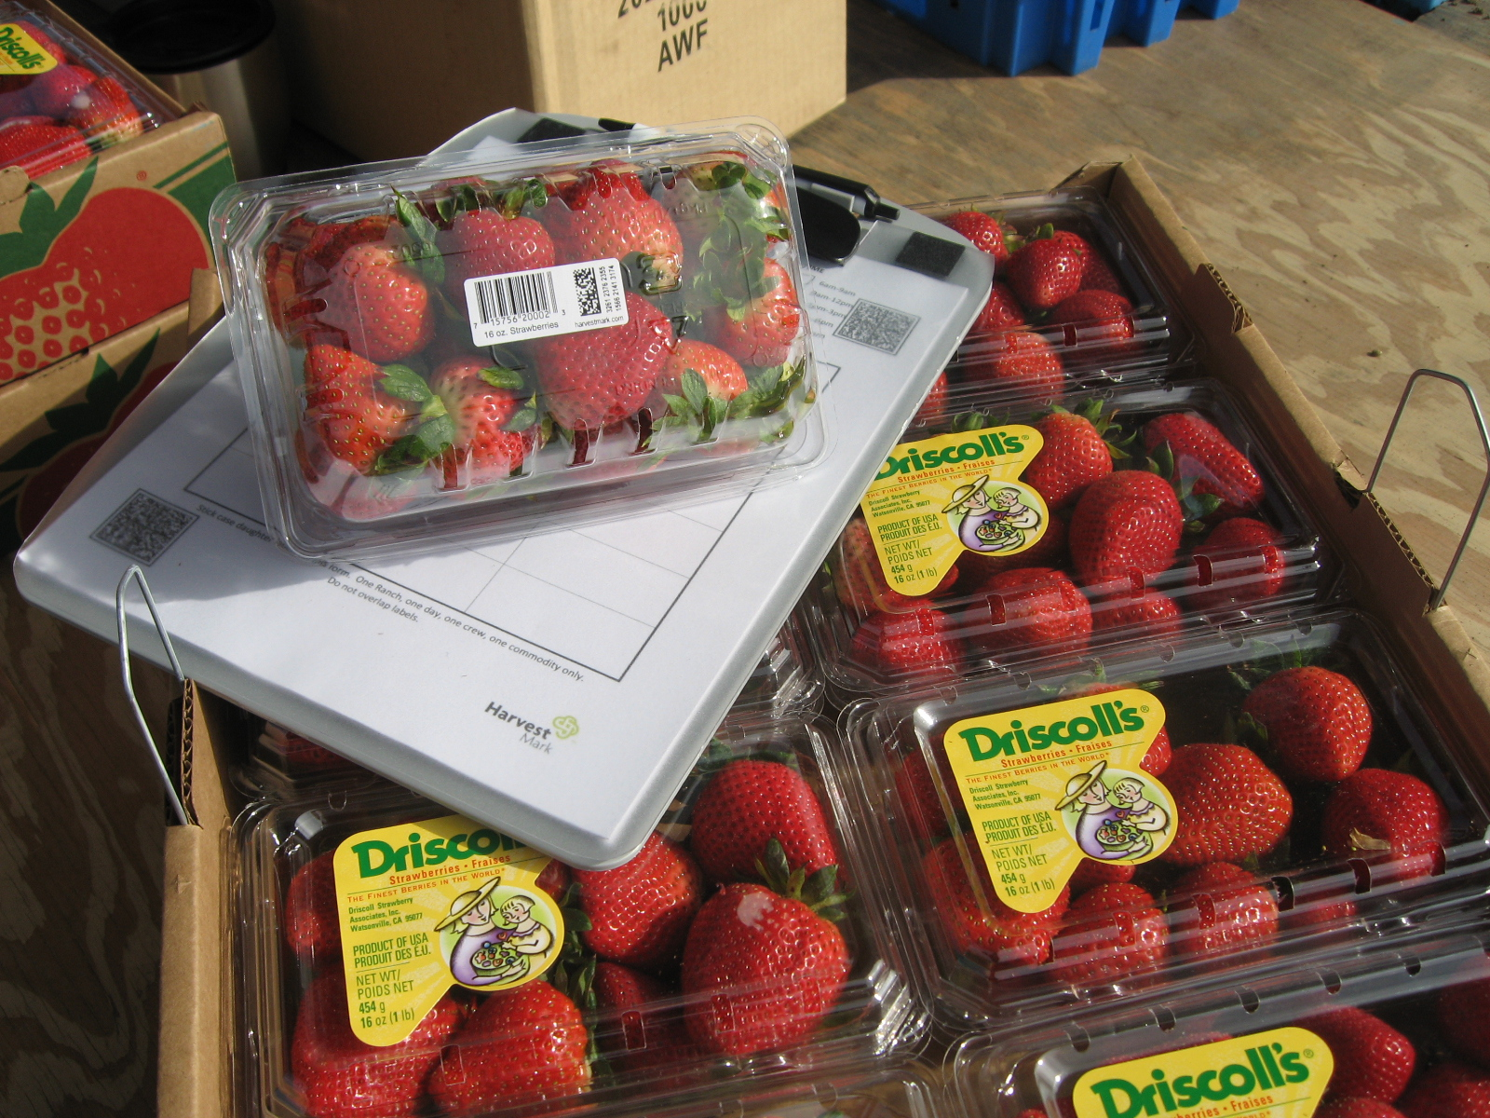
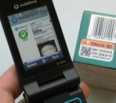
No Seafood Deployments….
Yet
HarvestMark Codes → Labels
(Or Print on Packaging)
In-store
Kiosk
Associate Items
to Cases (Optional)
HarvestMark
Data Center
At Home
Trace Responses
(Customizable, Permission Based)
On Mobile Phones
Capture Harvest Data
Notes:
As I think you know, we haven’t yet implemented traceability for seafood, YET!!! (although we have done Organic Chicken!). HOWEVER, the basic PROCESS for associating trace information to items, cases, or pallets is, in our experience, very similar between different commodities.

Slide 6
To commercially deploy traceability…
There are four key elements that define success
Understanding the producer’s workflow
Delivering meaningful information
Providing 24/7 access to the information
Running an industrial strength data service
… benefits retailers and their suppliers.
Notes:
….so you can create a traceability system that works (and minimizes the cost)
….that adds value to his operation
…..so inspectors, processors, distributors, retailers, and consumers get what they need – anytime, anyplace
…..Billions of Codes AND extensible applications…a system that will grow in size and scope

Slide 7
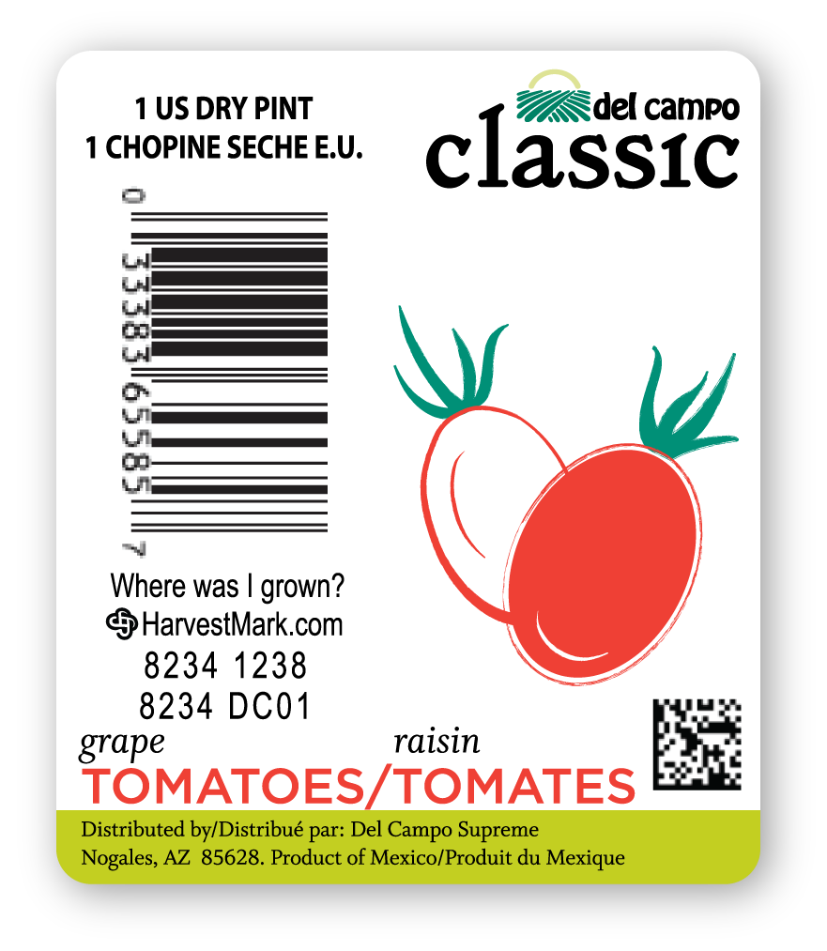
How does it work?

Slide 8
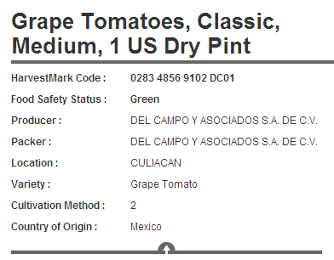
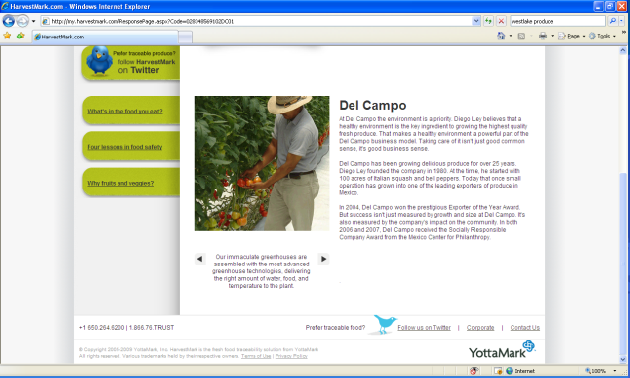
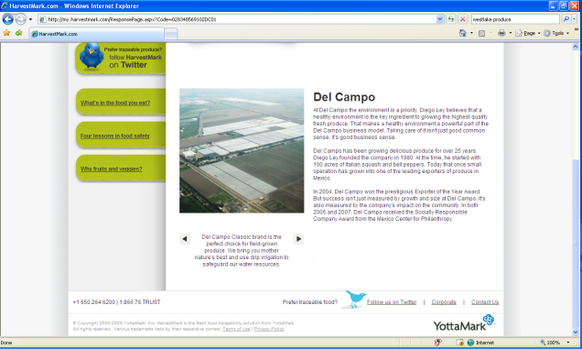
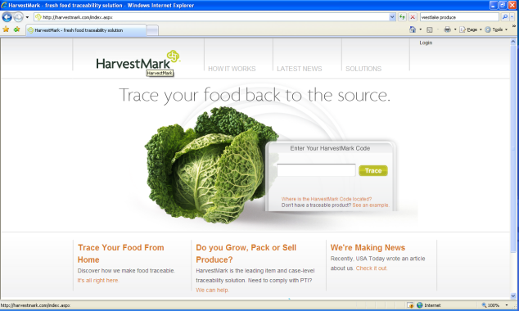
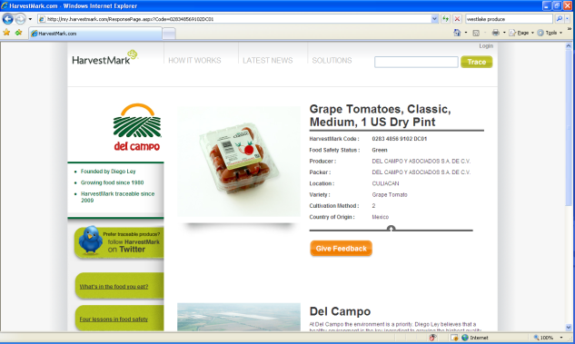
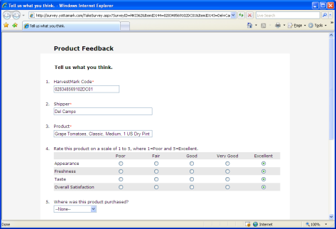
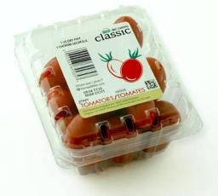

The Trace Experience
028348569102DC01

Slide 9
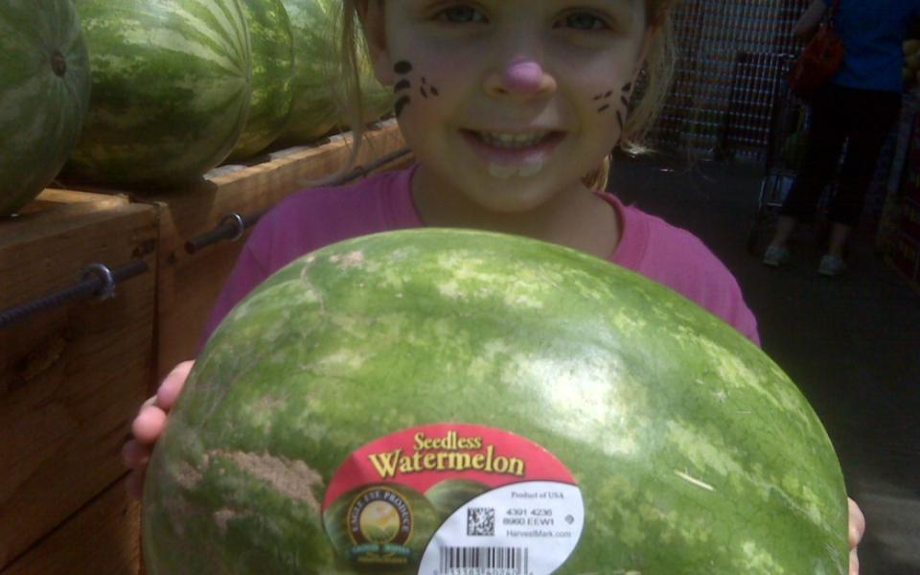

Food safety status
Product variety
Origin
Farm/ranch name
Maps
Distance to market
Harvest date
Lot number
Organic certificate
Solicit feedback
Twitter about this watermelon
Gallery of farm, harvest, photos, audio, video
Interesting, authentic narrative on growing practices, region, sustainability, etc.
Nutritional information
Fun facts for kids
Coupons
Regional, seasonal and family recipes

Slide 10
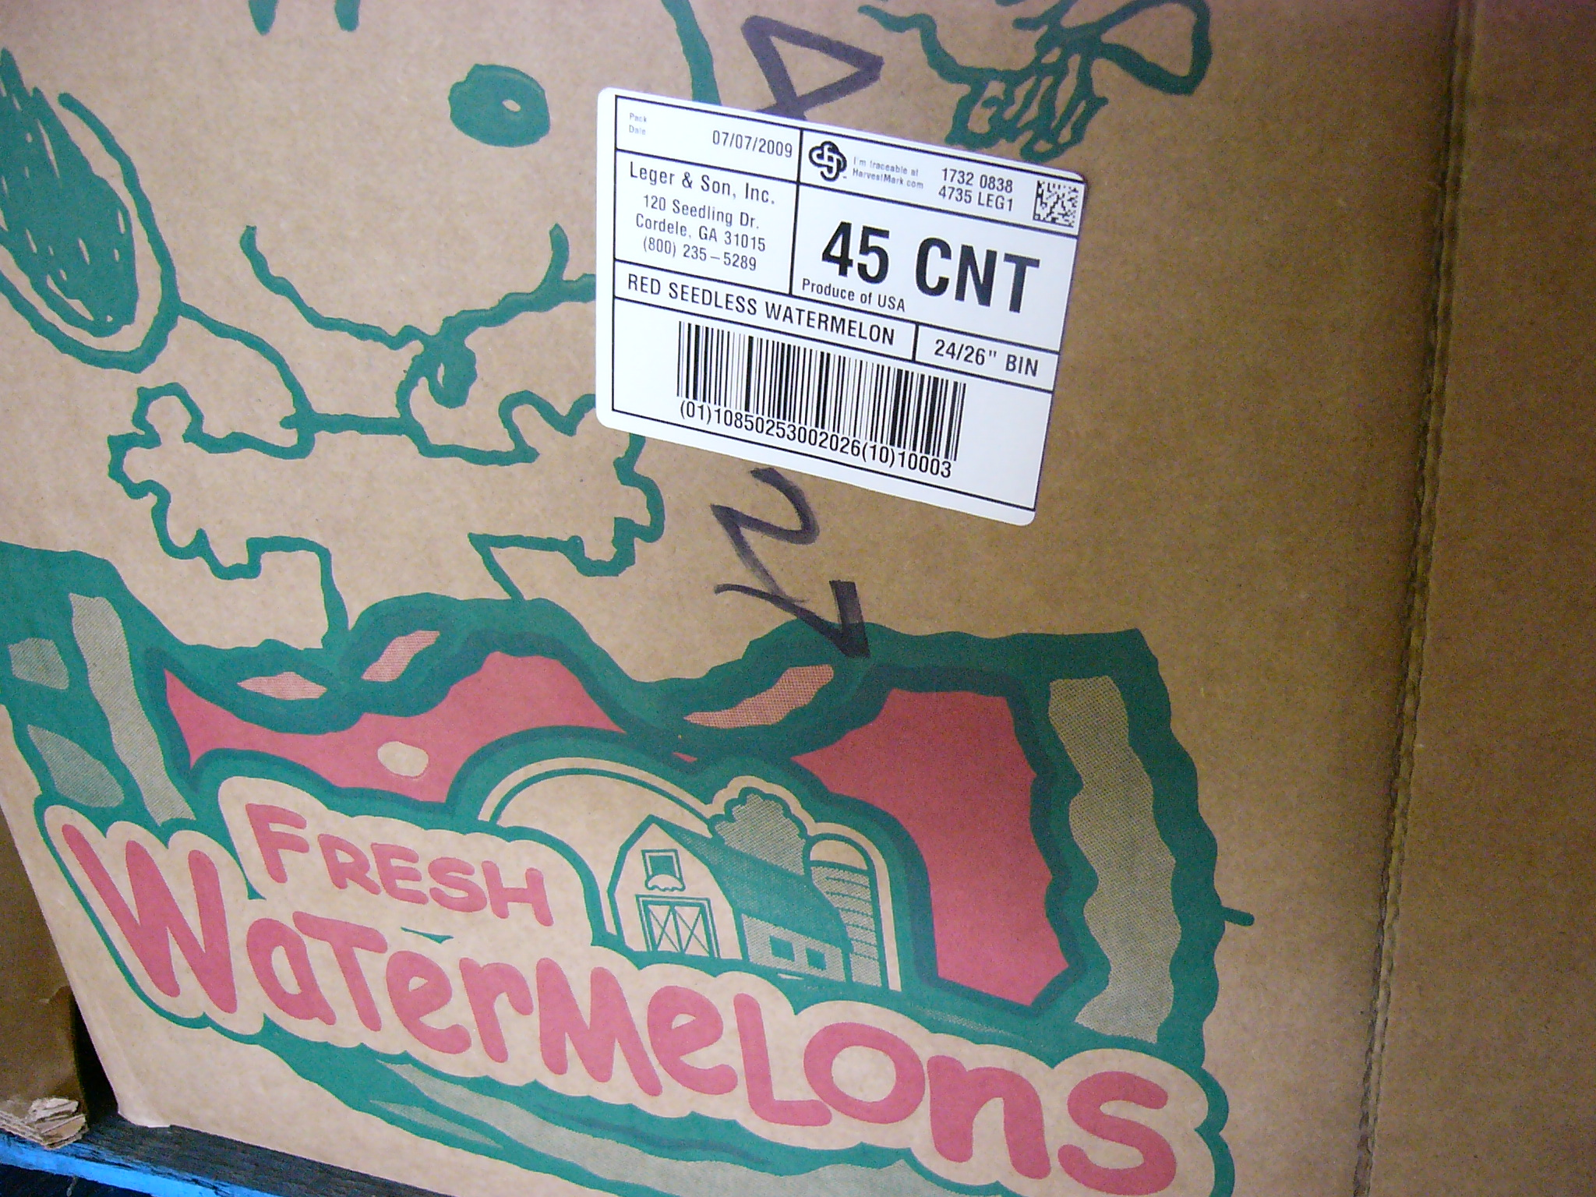
Food safety status
Product variety
Origin
Farm/ranch name
Distance to market
Harvest date
Pack date
Pack location
Lot number
Organic certificate
Rate quality
Pull time/temperature data
Visualize data on a map
Instantly access printable shelf/POS information – farmer profile, region information, recipes, preparation ideas

Slide 11
Consumers care!
17% No
“All things being equal, would you select traceable produce preferentially?”
83% Yes
Source: YottaMark survey of 2,700 households 2007

Slide 12
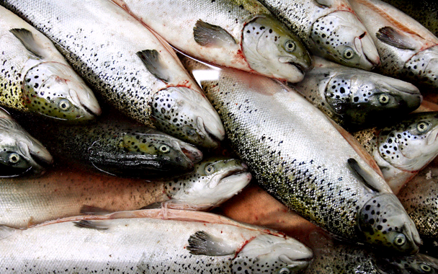
CatchMark?

Slide 13
Summary Points
Information Communication System
  Safety, logistics, certifications
  Customer/consumer marketing
Broad adoption: Producer -> Consumer
Adaptable to workflows
HarvestMark communicates what YOU choose to communicate

Slide 14
THANK YOU!
Questions?
Jonathan Hawes
Director, Business Development
HarvestMark
+1 503 825 1866
jhawes@harvestmark.com
www.harvestmark.com

