Slide 1
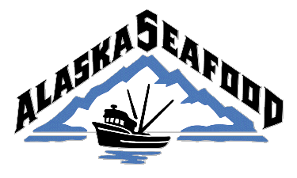
Alaska Seafood Marketing Institute
Presentation for
California Sustainable Seafood Initiative
2 August 2010

Slide 2
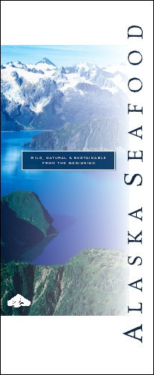
ASMI is….
State of Alaska corporation
a partnership of public and private sectors to foster economic development
guided by Governor-appointed Board of Directors: five processors, two commercial harvesters
Notes:
a partnership of public and private sectors to foster economic development of a renewable natural resource

Slide 3
ASMI Mission Statement
The Alaska Seafood Marketing Institute is a marketing organization with the mission of increasing the economic value of the Alaska seafood resource…

Slide 4
ASMI Funding
Voluntary Industry Self Assessment
State General Funds
Federal Funds for Overseas (cooperator in USDA Market Access Program; matched by industry and state funds)

Slide 5
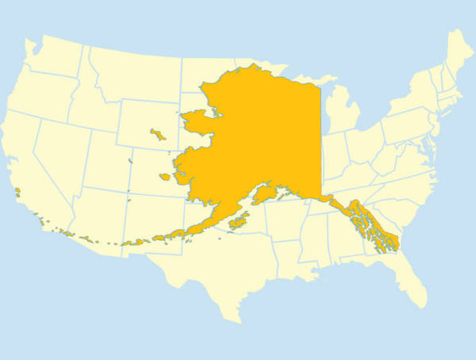
Alaska A Global Player in Seafood
More than 50% coastline of USA
1/5 landmass of USA
Alaska would be in the top 10 of seafood producing nations
62% of U.S. Production
Source: Northern Economics, 2009
Notes:
Alaska is big, not just in geographical size, but big in the seafood world as well, and so we are especially proud and pleased to host you here for this important international congress, and we believe it highly appropriate that this congress take place at the home of some of the world’s great sustainable fishery resources.

Slide 6
Alaska’s seafood industry
is worth $5.8 billion to Alaska in terms of direct and induced economic output (source: Northern Economics)
is the state’s largest private sector employer accounting for 54,000 jobs; and 11,000 jobs for nine months of the year
brings $90 million in tax revenue to state and local governments

Slide 7
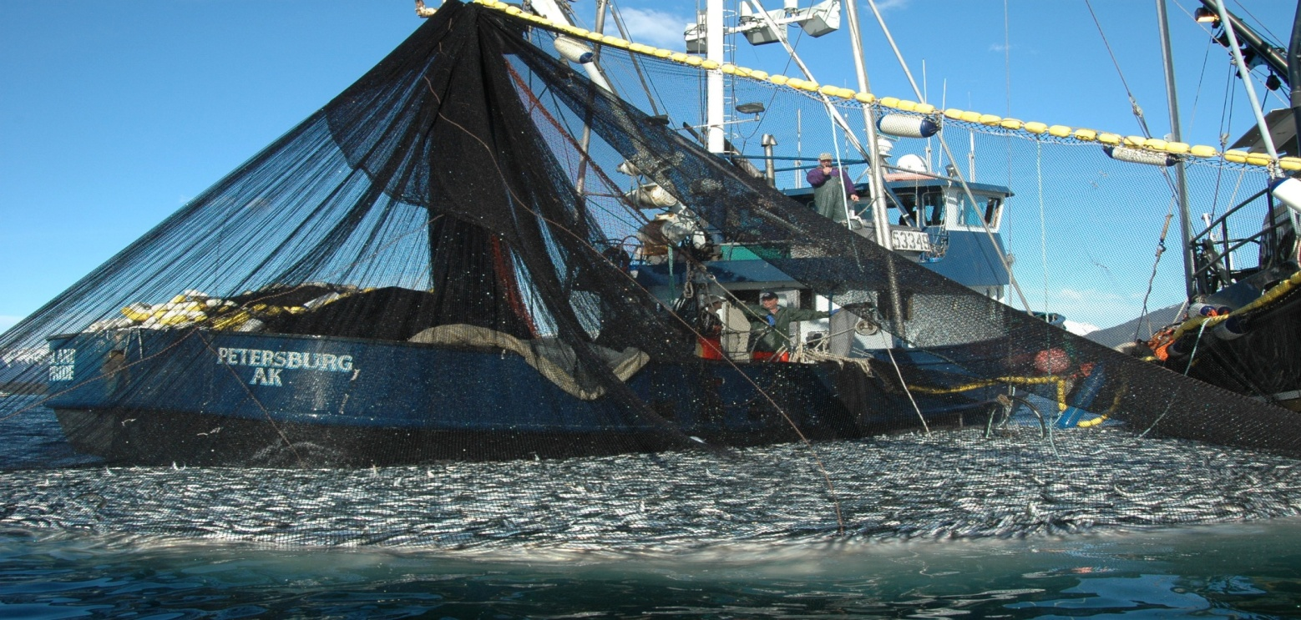
Sustainability
World’s resources coming under increasing pressure
Need for sustainable utilization is paramount
Sustainability the topic du jour
Notes:
Sustainability is now mainstream in the dialog and a major topic in nearly all discussions about seafood around the world.
We in Alaska are proud of our more than 50 year commitment to sustainable management of our fish resources. For seafood to continue to play it’s critical role in the world’s nutrition and trade, sustainable production is essential. We believe the Alaska approach can be a model for those countries around the world who are struggling to improve their own fishery management.

Slide 8
Sustainability Not New in Alaska
Sustainability and Responsible Fisheries Management has been an element of Alaska efforts for more than 50 years
Part of Alaska story-delivered by ASMI along with other key attributes of Alaska: purity, quality, wild, natural

Slide 9
Alaska Seafood’s Sustainability
Based on:
State Constitutional mandate for sustained yield
Historic Effectiveness – 50 year commitment
Precautionary Approach
Sound Science
Transparent Public Process
Collaboration
Conformance to International Guidelines (i.e. FAO)
Outside Recognition
Family and Community Sustainability
Notes:
Constitution established in 1959
Record harvests in recent years for salmon ( Top 4-salmon harvests have come between 1995 and 2007)

Slide 10
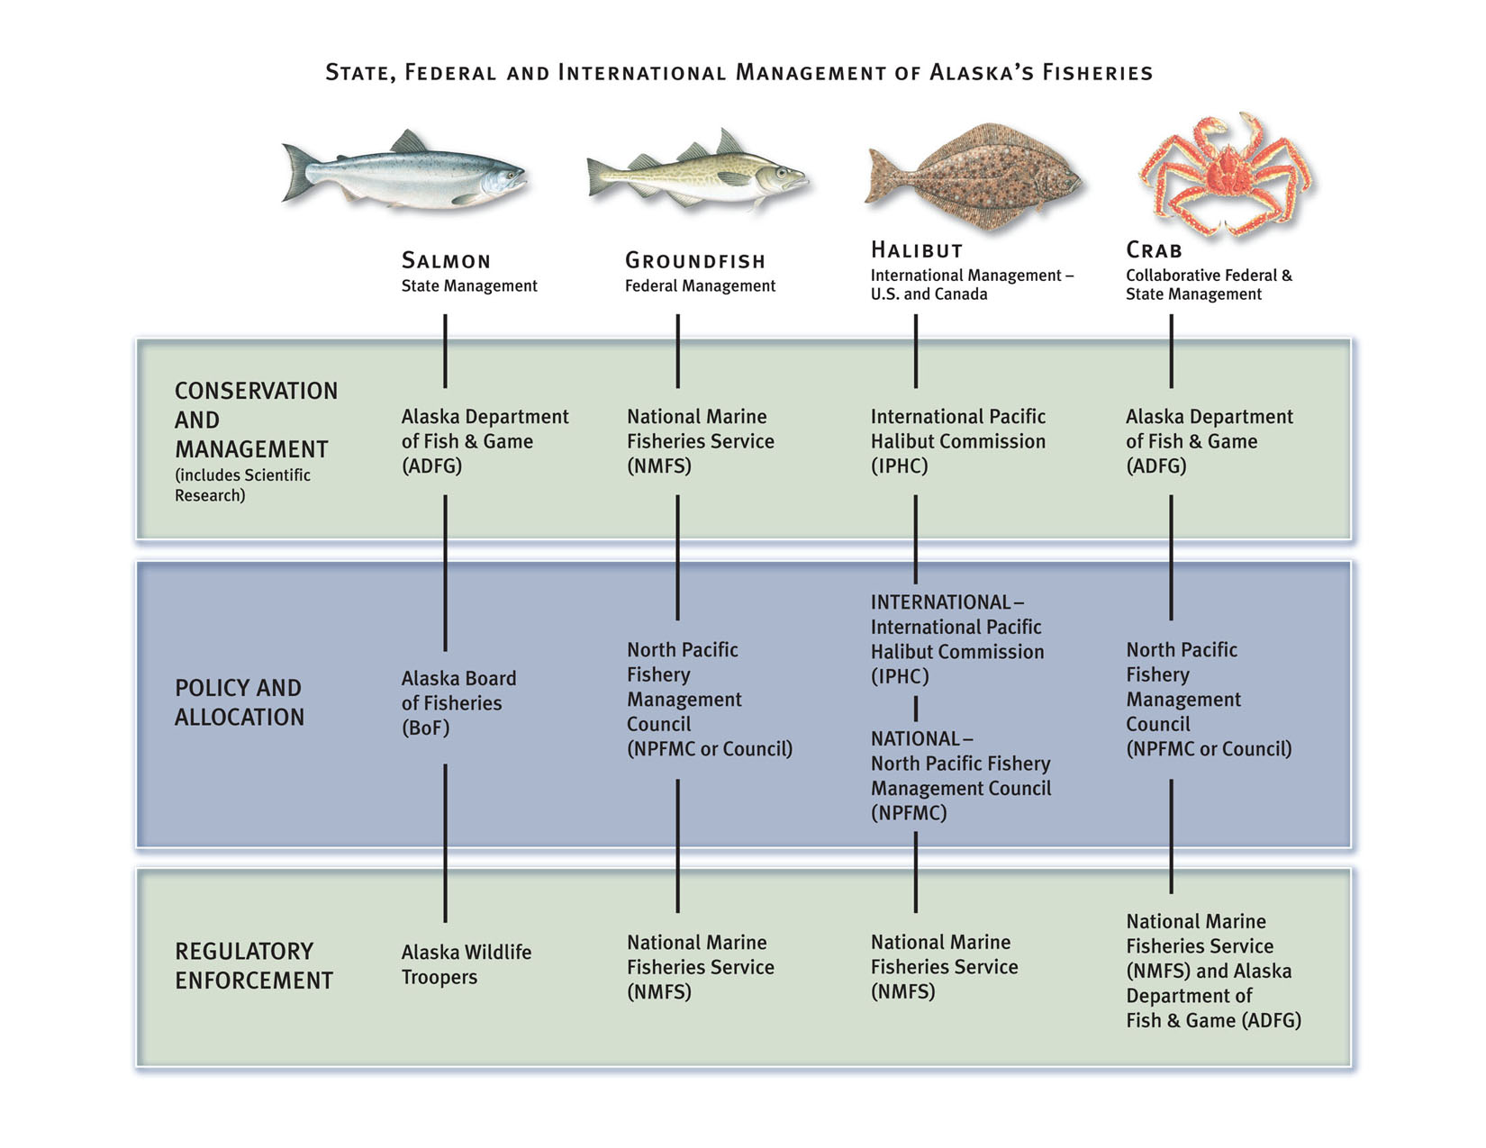
**Separation of Conservation from Allocation
© 2008 ASMI

Slide 11
Marketplace Situation
The sustainable seafood movement has gone from a niche concept to a mainstream concept
Worldwide, retailers and food service operators are responding to pressure to demonstrate corporate and social responsibility.
Sustainable seafood is becoming a market requirement

Slide 12
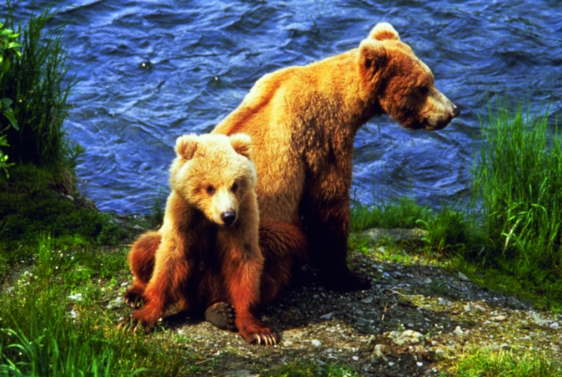
“Sustainability is too important to be left to the marketplace”
- Quentin Clark of Waitrose, Ltd. in the United Kingdom
Notes:
Operators today must themselves embrace corporate responsibility and do what is right in providing consumers with safe and responsible seafood. Consumers rely on the foodservice operator and retailer to provide this for them.
As Quentin Clark of Waitrose, Ltd. in the UK said, “Sustainability is too important to be left to the marketplace.”
Put another way, fisheries management should be the province of governments, and governments should be held accountable. We would not dream of leaving an issue such as food safety to numerous third party certifications. We expect our governments to oversee food safety in a science-based regulatory fashion, with a transparent public process. We would not embrace the concept of different food safety labels on packages, each contending theirs is safer.

Slide 13
Consumers and even buyers are challenged by conflicting messages
Depends on Who You Are Listening To:
Consume more?
Consume less?
Only consume selected species?
Seafood sustainability:
Less than one-half of consumers can correctly define sustainability (source: Hale Group 2008).
The proliferation of sustainable seafood eco-labels, endorsements and certifications has created confusion among consumers and trade.

Slide 14
© 2008 ASMI
Slide courtesy Roger Bing, Darden Inc

Slide 15
ASMI developing Alaska Sustainability Platform for nearly four years
Document and communicate how Alaska manages its fisheries responsibly and in accordance with international guidance United Nations Food and Agriculture Organization (FAO) Code
FAO Code a focal point of Alaska platform

Slide 16
Alaska Platform
ASMI developed numerous materials and conducted outreach to educate on Alaska fishery management system
Platform highlighted world recognition Alaska has received and how Alaska has been a leader
Platform was geared to demonstrate Alaska credentials can stand on their own
Notes:
16

Slide 17
2009 ASMI Board directed staff to evaluate certification alternatives for Alaska Platform
Why? Industry and Trade asked for an inexpensive 3rd party alternative to eco-logos
Notes:
17

Slide 18
Customer Advisory Panel
Kroger (US)
Dardens (US)
Sysco (US)
Harris-Teeter (US)
Birds-eye Igloo, EU
Waitrose, UK
Pan Fish Company (China)
Kibun Foods (Japan)

Slide 19
Selected: Global Trust Certification Ltd
Global Trust recognized and experienced in fisheries certification and seafood
Notes:
19

Slide 20
Provides Assurance
Independent certification provides further assurance to customers and markets that require 3rd party verification
Through this program we provide the means to demonstrate Alaska origin means sound fishery management
Notes:
20

Slide 21
ASMI funded certification
Model will not entail logo licensing costs
Program is separate from and does not impact other logo schemes
Provides alternative to eco-label programs
Notes:
21

Slide 22
NOT a consumer facing logo scheme
Communication mark and messaging left to stakeholders
ASMI logo as origin indicator (Alaska) available free to users of Alaska product-now backed by 3rd party certification
Emphasis is on certification of fishery management rather than on the logo
Alaska model similar in concept to Icelandic approach
Notes:
22

Slide 23
Bottom Line Upon Completion:
Fishery management of major Alaska fisheries will be independently verified against the most widely recognized principles and criteria of responsible fisheries management = FAO Code of Conduct for RFM
Expect first fisheries through the certification program by this time next year
Notes:
23

Slide 24
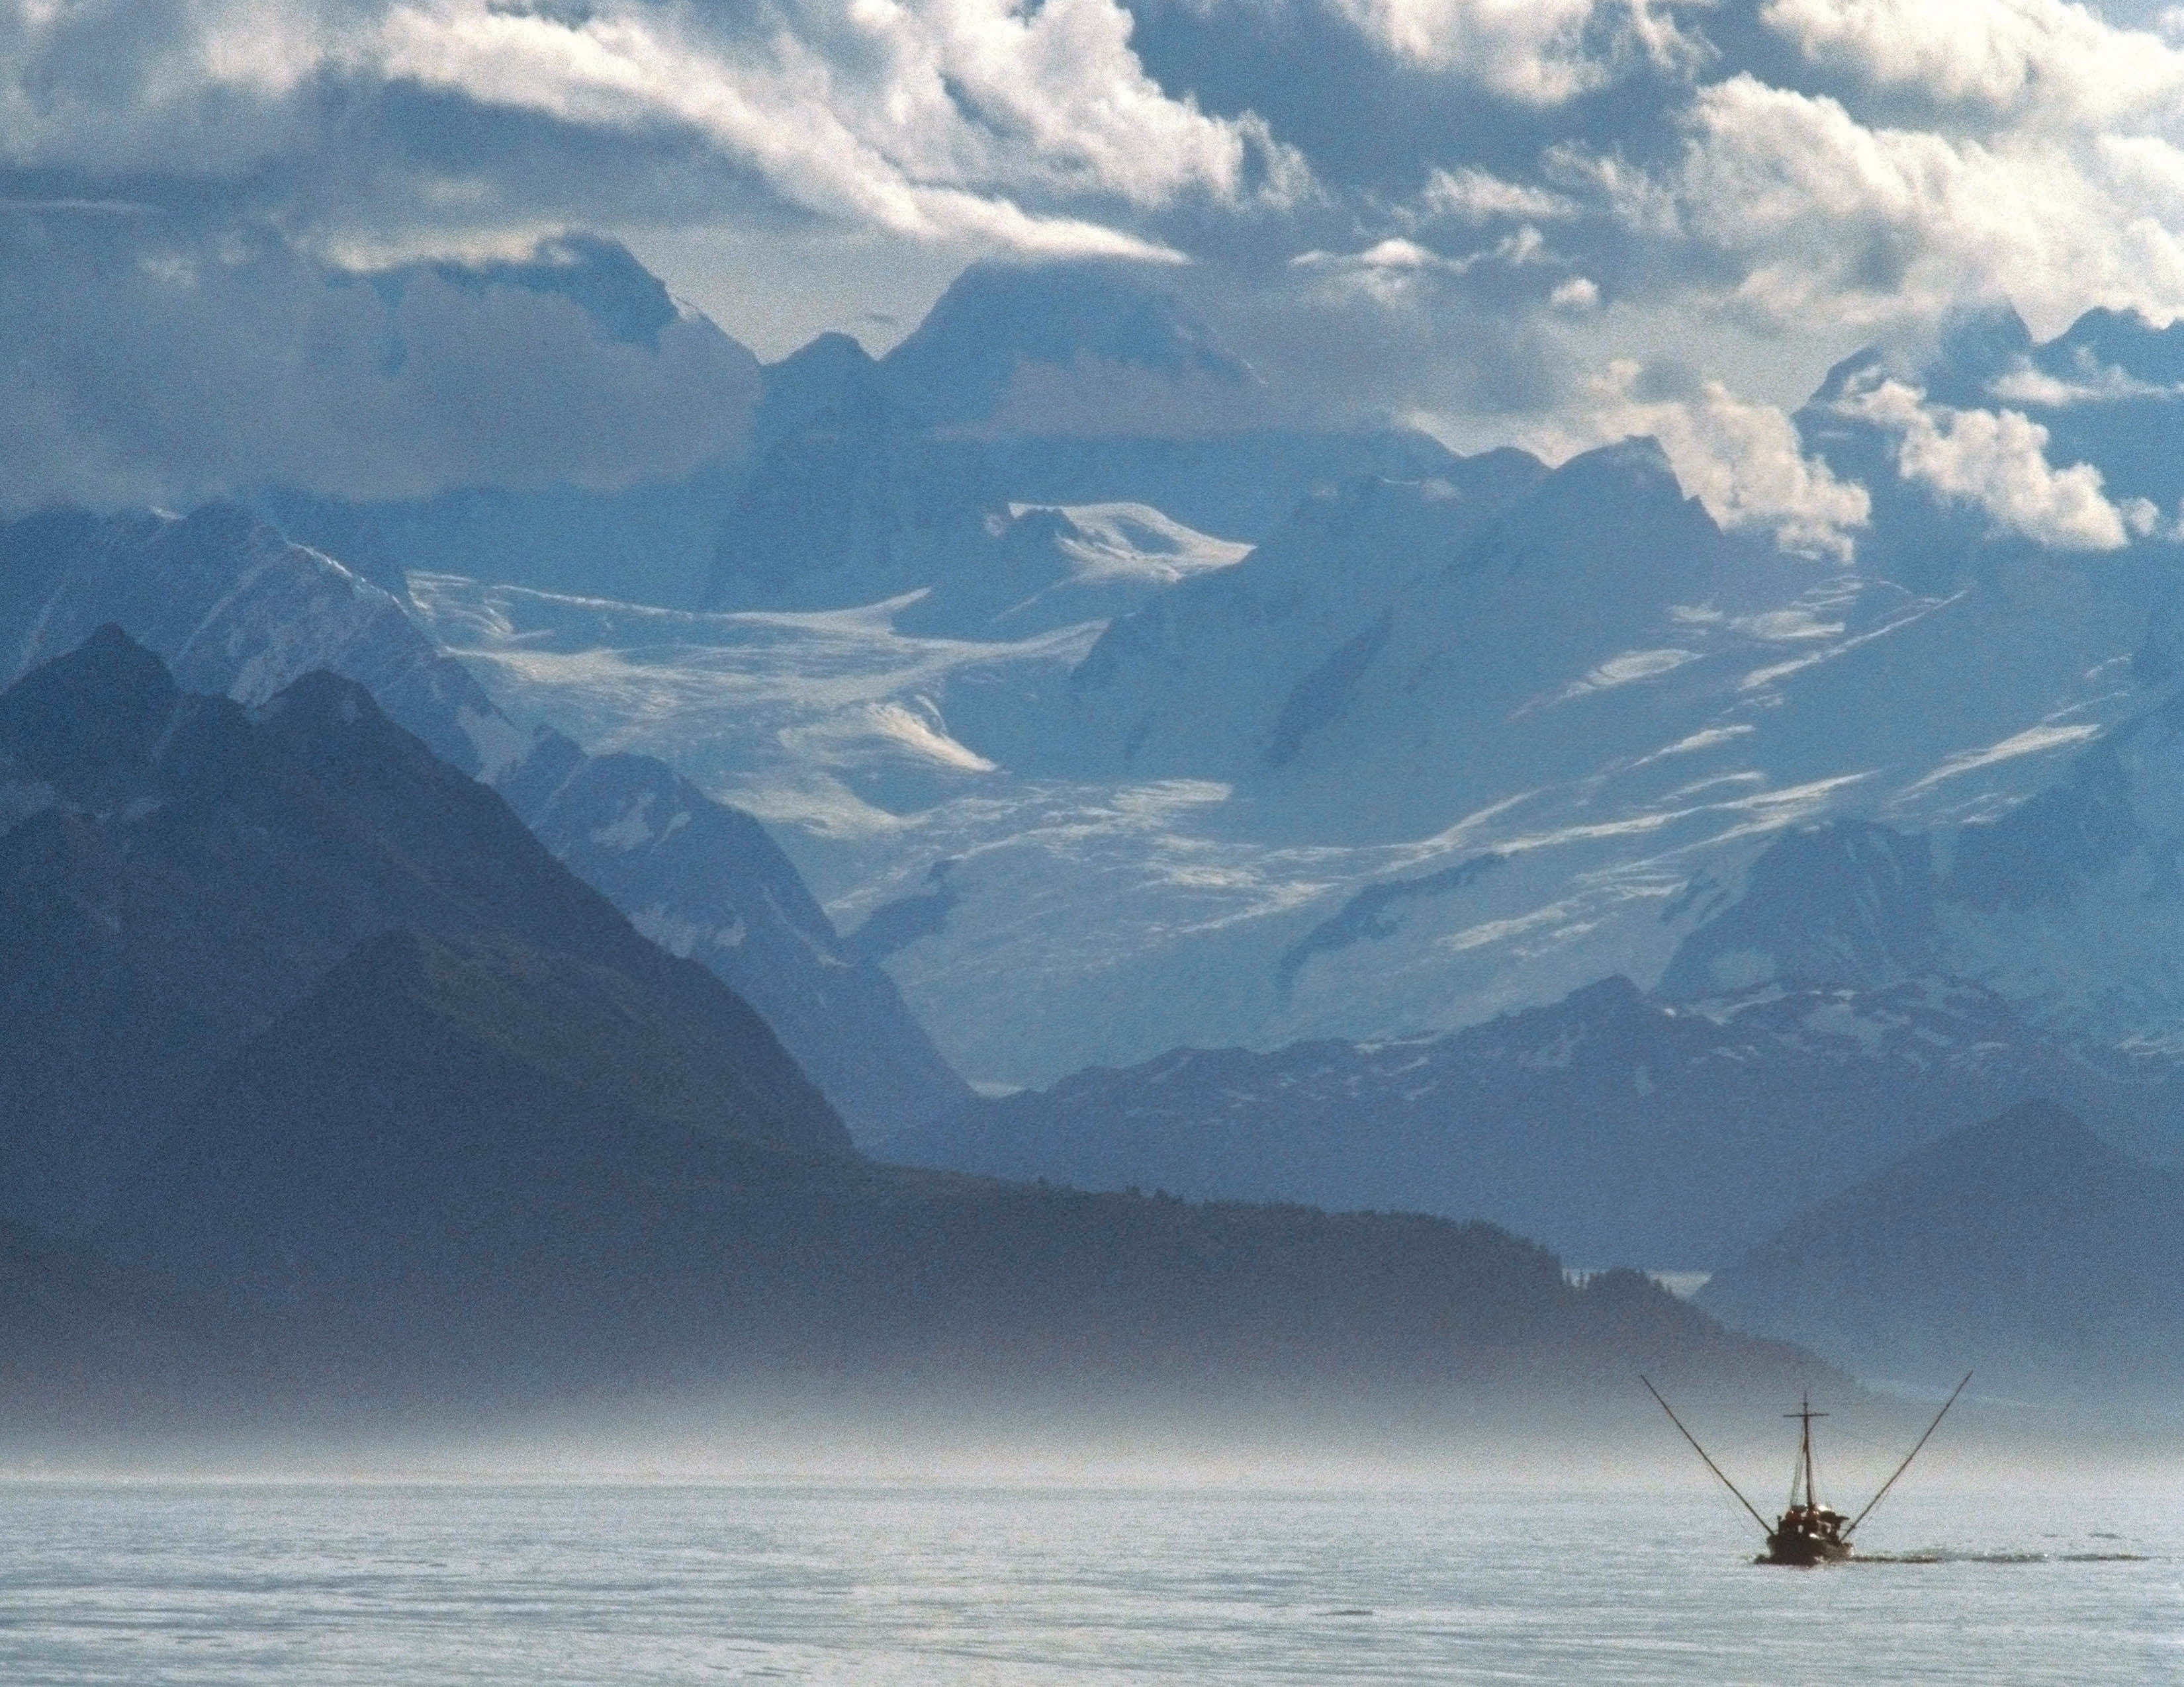
United Nations Food and
Agriculture Organization
International authority on food production
Neutral forum
Not agenda driven
Comprehensive principles, criteria and methods
Serves as a template
Notes:
The FAO Code of Conduct can serve as an excellent international standard and baseline:
The FAO is an international authority on food production.
And it is a neutral forum where all nations meet as equals to negotiate agreements – it’s not agenda driven.
The Code is recognized for its comprehensive principles, criteria and methods and serves as a template for many certifications.
In short, it contains the fundamental elements needed and relevant for responsible fisheries.
We would like to note that long before the FAO Code was even established, Alaska has held itself accountable to these same strict standards – one of the reasons that Alaska is recognized around the world as the model of sustainability. In fact, Alaska can serve as an example for how to implement the principles and criteria found in the FAO Code.

Slide 25
FAO Checklist
Provides a straightforward, comprehensive, objective measure against an independent standard
Can be applied to any wild fishery
Notes:
A useful tool for evaluating a fisheries’ conformance to the Code of Conduct is the FAO Checklist. This checklist provides a straightforward, comprehensive, objective measure against an independent standard and it can be applied to any wild fishery.

Slide 26
Certification
Common agreement that Certification should be independent third party
1st Party – e.g. Audit One-Self
2nd Party – e.g. A supplier / vested interest
3rd Party – No commercial interest
Notes:
26
26

Slide 27
Accreditation of Certification
Common agreement that Accreditation should be ISO 65 from a Member of the International Accreditation Forum (IAF) (e.g a National Accreditation Body)
Accreditation delivers confidence on Consistency and Competency
“IAF” ensures the credibility of the Accreditation Body – they too must meet a standard of consistency and competency
Notes:
27
27

Slide 28
Alaska Seafood Chain of Custody
1. Verification of the origin and traceability of Alaska seafood to certified Alaska fisheries
2. That a business has a working, legally compliant traceability system and can assure customers of the authenticity of Alaska Seafood branded products’

Slide 29
International Norms -CoC
ISO22005 (Traceability in food chains –
General principles and basic requirements for system design and implementation)
ISO/IEC Guide 59 Code of Good Practice for Standardization
WTO Technical Barriers to Trade Agreement Annex 3 Code of Good Practice for the Preparation, Adoption and Application of Standards.

Slide 30
Certification lesson learned
Sustainable fisheries management is a government responsibility; third parties only certify and should not dictate to fisheries managers
Focus on the management, not individual stocks…engage with your fishery managers upfront
Point to the FAO Code
Don’t split up your fisheries

Slide 31
Certification lessons learned
It is expensive; control your costs
Don’t loose your brand in the process
Know your target markets and what they are looking for
Available to all stakeholders, not just those who buy a logo
You are using public funds…there are many competing interests for these dollars

Slide 32
Sustainability…An evolution?
Many world fisheries grossly mismanaged and overfished
Few people really paid attention
NGOs brought pressure to change
Trade began partnering with NGOs in marketplace
Eco-logo’s to reward responsible fisheries
Industry and Trade getting it…consumers?
A requirement to go to market…like food safety
Background 3rd party assurance as part of Trade Corporate Social Responsibility programs

Slide 33
“Alaskans are acutely aware that successful management of the multitude of marine and anadromous fish stocks of the Bering Sea and the Gulf of Alaska is an inheritance bestowed on us by generations of dedicated professionals who have studied the life histories, habitats and productivity of these various resources.”

Slide 34
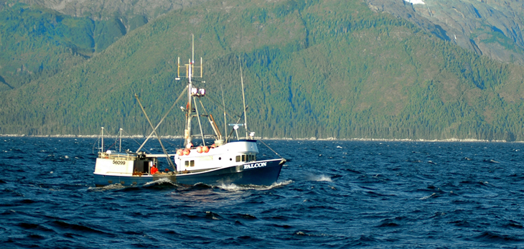
Many of our predecessors had to make difficult decisions at times, to forego or to reduce harvest, in order to protect long-term sustainability.

Slide 35
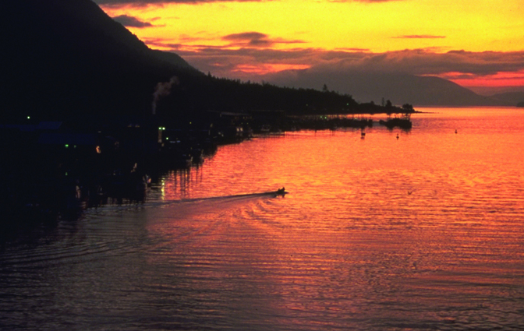
As the current custodians of these immensely valuable and renewable resources, we honor their work by continuing it.”
Denby S. Lloyd, Commissioner,
Alaska Department of Fish & Game (ADF&G)
Notes:
35

Slide 36
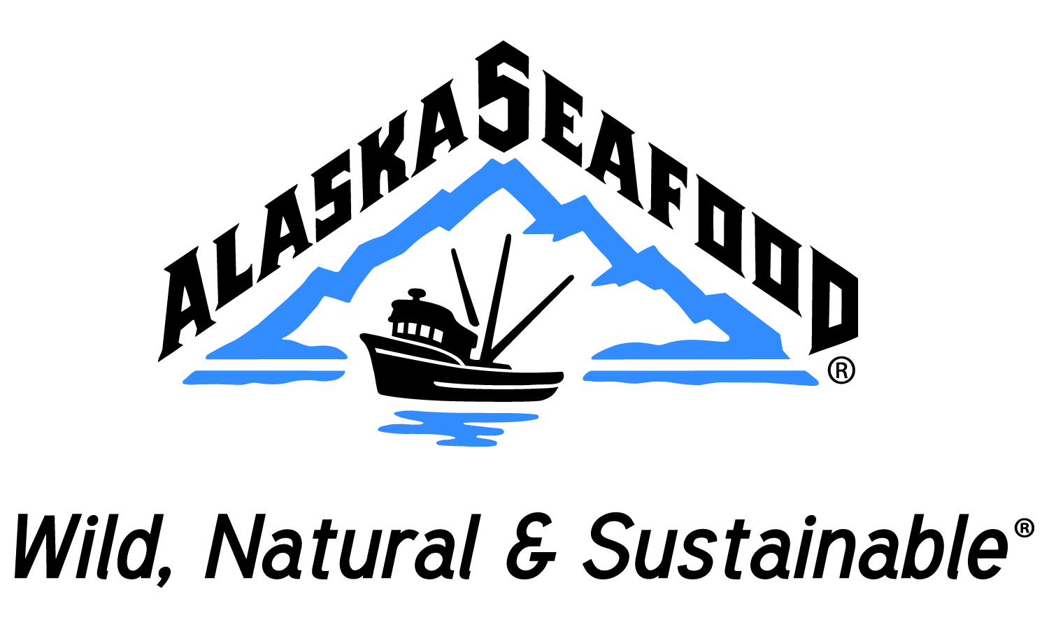
Alaska Seafood Marketing Institute
311 North Franklin Street
Juneau, AK 99801
Phone: (907) 465-5560
Toll Free: (800) 478-2903
Fax: (907) 465-5572
Email: info@alaskaseafood.org
Website: www.alaskaseafood.org

